Slide 1
Final Assignment
Algorithm Design and Analysis:

Slide 2
Super Egg Dropping Problem:
Team Members:
Muhammed Mù Fēi - 2120216007
Santosh Devkota-2120216008
Inocˆencio Nanlelo - 2120216023

Slide 3
Problem:
You are given 𝑘 identical eggs and you have access to a building with 𝑛 floors labeled from 1 to 𝑛. You know that there exists a floor 𝑓 where 0 <= 𝑓 <= 𝑛 such that any egg dropped at a floor higher than 𝑓 will break, and any egg dropped at or below floor 𝑓 will not break. Each move, you may take an unbroken egg and drop it from any floor 𝑥 (where 1 <= 𝑥 <= 𝑛). If the egg breaks, you can no longer use it. However, if the egg does not break, you may reuse it in future moves. Return the minimum number of moves that you need to determine with certainty what the value of 𝑓 is.

Slide 4
Analysis of Problem:
We have Number of eggs = e
We have Number of floor = f
The critical floor = k (from this and above this floor if
eggs drops it breaks.
f
k
Floor
e
Eggs
Main Problem: We have to find the minimum attempts required to find the critical floor.

Slide 5
1+ MIN [MAX1, MAX2, MAX3,MAX4]= Guaranteed attempt
MAX4
MAX3
MAX2
MAX5
e-1/1
e/f-k
e-1/2
e-1/k-1
e/f-3
e/0
e/f-2
e-1/f-1
MAX1
e-1/0
3
e/f-1
k
2
f
1
e/f
Logic Behind the Solution:

Slide 6
Core idea to Solve this problem:
We perform Project estimation, Project: find the critical floor, we estimate the minimum attempt that we find the critical floor.
While estimating: depends on our luck whether egg breaks or not so we assume the worst will happen
We select the best from the worst which gives our plan is 100% successful
Base cases are:
Floor/egg attempts
f = 0 0
f= 1 1
e =0 we cannot perform
e =1 f
survive
e, f-k
k
e, f
breaks
e-1, k-1
We use Dynamic memorization strategy or tabular method:

Slide 7
Pseudo code:

Slide 8
Table to solve: suppose given (3 eggs and 7 floor)
 | 0 | 1 | 2 | 3 | 4 | 5 | 6 | 7
0 | 0 | - | - | - | - | - | - | -
1 | 0 | 1 | 2 | 3 | 4 | 5 | 6 | 7
2 | 0 | 1 | 2 | 2 | 3 | 3 | 3 | 3
3 | 0 | 1 | 2 | 2 | 3 | 3 | 3 | 3
ELSE //dp[n+1][k+1]
Set a mini with maximum Integer value
For new Integer variable mj = j-1 to mj>=0 and pj = 0 to pj<=i
Find the maximum of dp[i][mj] and dp [i-1][pj] and store into new variable Val
Store the minimum of Val and mini to variable mini.
Store the value of mini by adding 1 to Array dp[i][j] for memorization

Slide 9
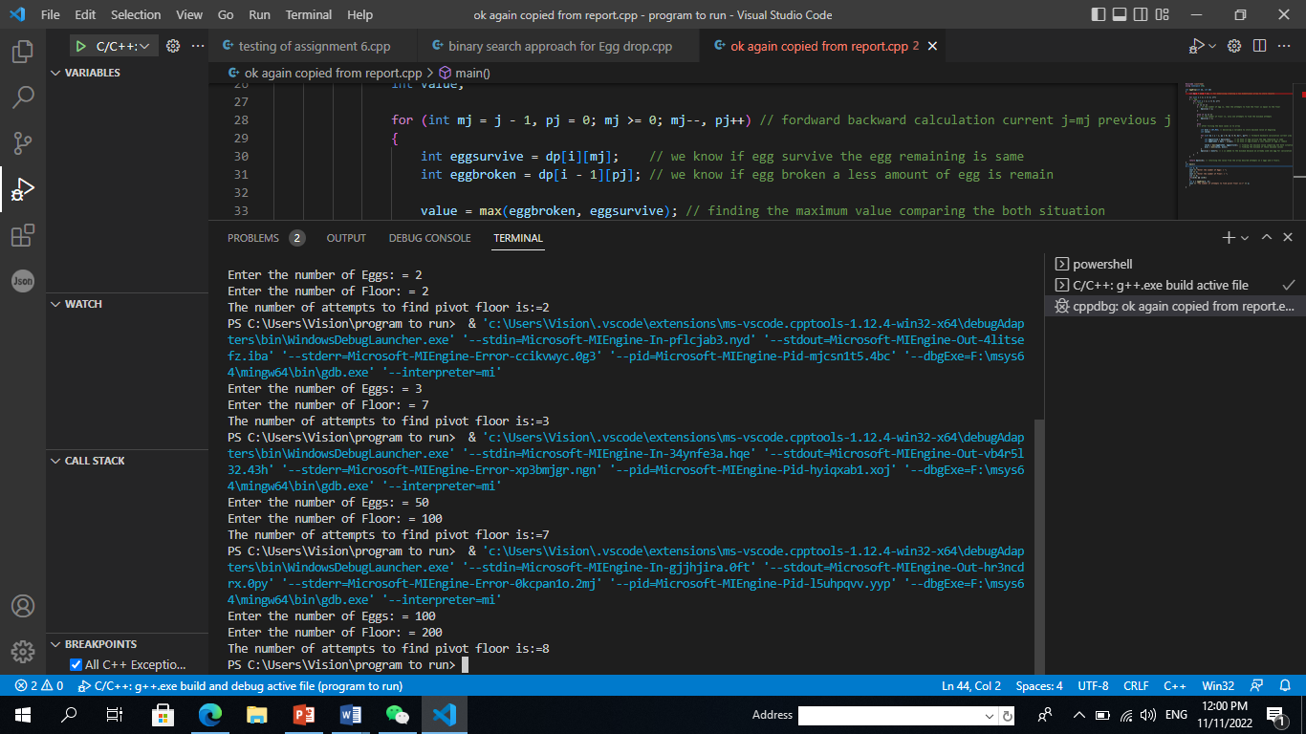
Output generated by Program:

Slide 10
Time Complexity Analysis:

Slide 11
Time Complexity can optimize By using Binary Search :
This can be minimize to-- logn

Slide 12
Binary Search approach:
Initialize a two dimensional array ‘dp’ with size [n + 1] [k + 1]. [Where n is number of eggs and k is number of floor]
For i is equal to 1 to k+1 and j is equal to n+1
If ‘i’ equal to 1, then:
dp[i][j]=j
ELSE IF ‘j’ is equal to 1, then:
dp[i][j]=1
ELSE
Declare local variables mr=j, lr =1, temp =0 and store maximum integer value to minn variable.
WHILE(lr<=mr) --------- perform binary search approach
INTEGER mid = lr+mr /2;
INTEGER left = dp[i-1][mid-1] and right = dp[i][j-mid]
Temp =1 + MAXIMUM of left and right
If left<right then lr = mid+1
else mr = mid-1
minn = MINIMUM of minn and temp
Store the the minn value to dp[i][j]
.
Return dp[n][k].

Slide 13
Time complexity:

Slide 14
Team Member Contribution:
Design algorithm----------- Santosh Devkota [2120216008]
Implement source code ----- Muhammed - Mù Fēi [2120216007]
Prepare report -------------- Inocˆencio Nanlelo [2120216023]

Slide 15
Thank you!!

